Slide 1
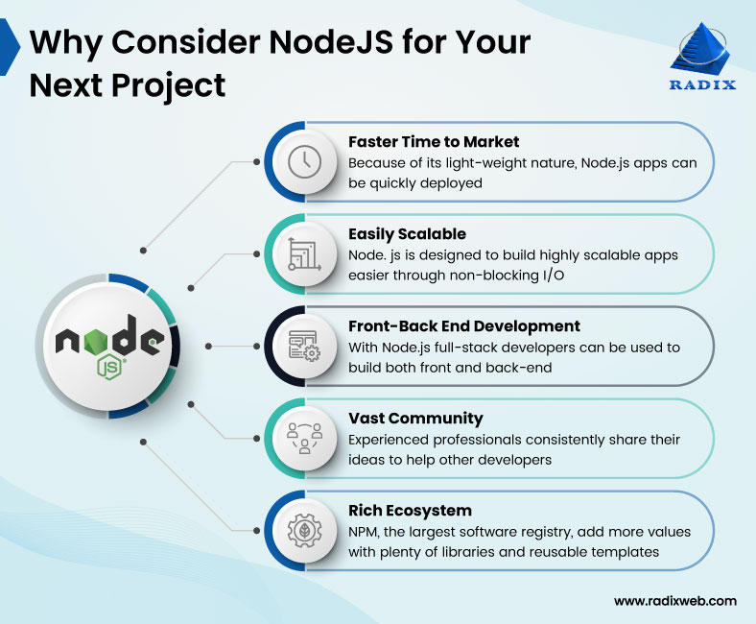

Slide 2
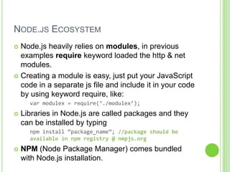

Slide 3
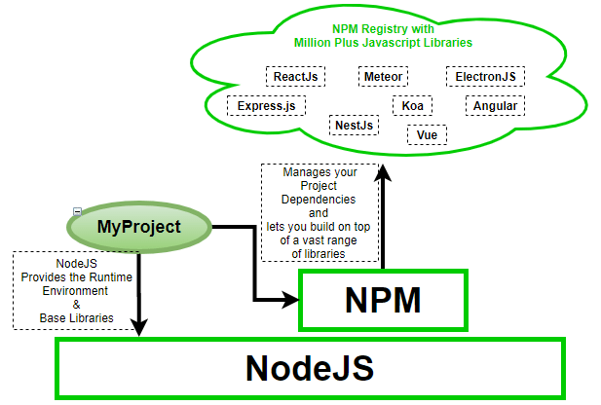

Slide 4
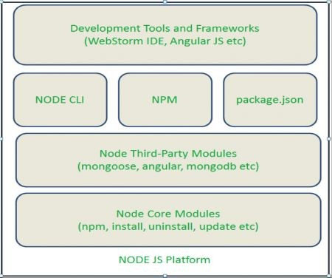
UNIT 3 third party modules

Slide 5
What Is a Package
In Node.js, a package includes every file required for a module.
You can add modules in JavaScript libraries to your project

Slide 6
What is third party module
The third-party modules in Node.js are those we install globally or on our local machines from external sources, typically via the Node package manager.
Third-party modules are essential for expanding the capabilities of Node.js applications beyond what is provided by core modules.
For example, there's a package called CAPITALIZE. It performs functions like capitalizing the first letter of a word.

Slide 7
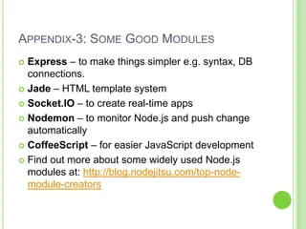

Slide 8
First talk about Node Package Manager(NPM)
The npm (Node Package Manager) plays a pivotal role in the Node.js ecosystem, serving as the central repository for hosting and sharing Node.js packages.
It not only facilitates the discovery and installation of third-party modules but also assists in managing project dependencies efficiently.

Slide 9
npm is more than just a package manager; it's a comprehensive platform for publishing, discovering, and installing Node.js packages.
It significantly simplifies the process of sharing code across projects and teams, making it easier to extend the functionality of Node.js applications by incorporating a wide array of libraries and tools available in the npm registry.

Slide 10
Searching For And Installing Third-Party Modules From The Npm Registry
The npm registry (https://www.npmjs.com/) hosts thousands of packages for various functionalities, from web frameworks to utility libraries.
Developers can search for packages directly on the npm website or use the npm CLI (Command Line Interface) with commands like npm search to find packages relevant to their needs

Slide 11
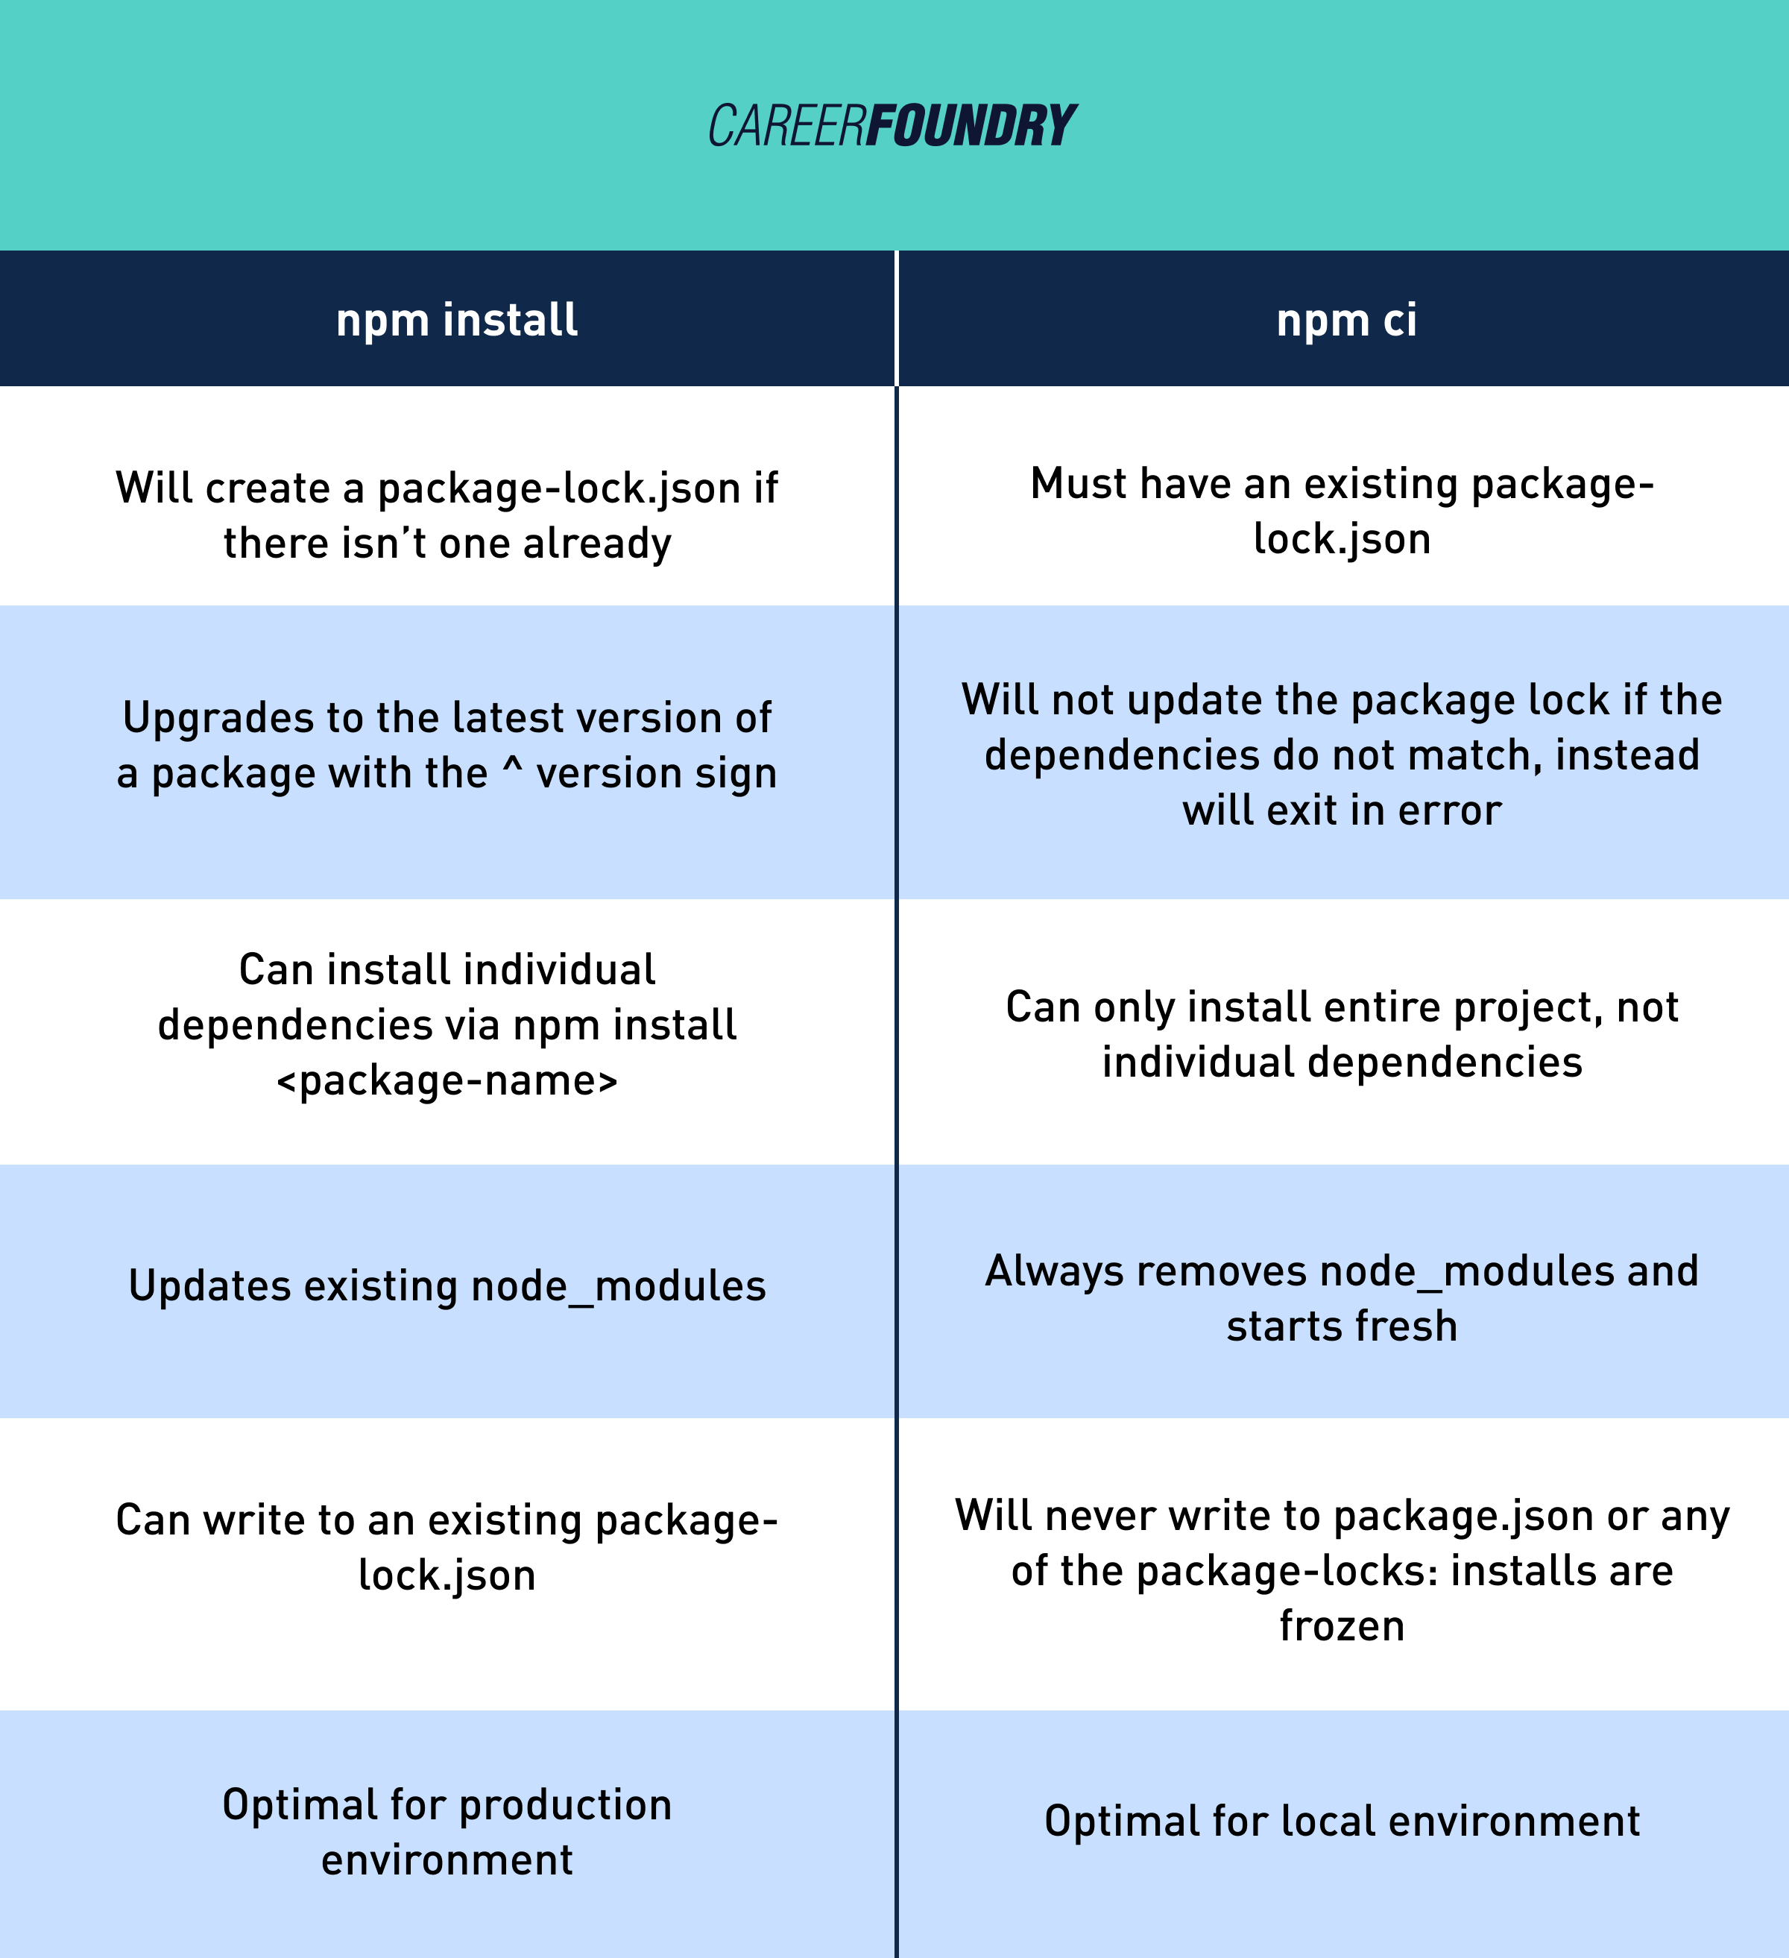

Slide 12
Managing Dependencies In Your Projects Using Package.Json And Package-Lock.Json
Package.json file
The package.json file is a vital component of any Node.js project managed with npm.
It keeps track of all the project's dependencies, specifying the versions of third-party modules the project relies on.
When a package is installed, npm updates the package.json file accordingly, providing a clear overview of the project's dependencies

Slide 13
package-lock.json file
The package-lock.json file, on the other hand, locks down the exact versions of all packages and their dependencies installed in the project.
This file ensures that all team members and deployment environments use the same versions of each package, mitigating the risks associated with version discrepancies.

Slide 14
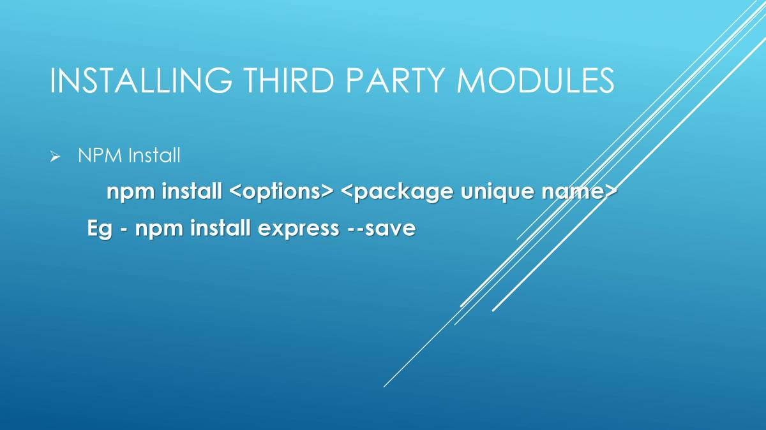
How to install third-party modules
To use a third-party package in your application, you first need to install it.

Slide 15
After installing the third-party module, we can require it in our code using the following command:
const thirdPartyModule = require(thirdPartyModuleName)

Slide 16
Let’s take an example
Let's understand the third-party module further with a sample code. We will use the ‘lodash’ module, which is a third-party module useful in the manipulation of arrays.
Run the following command
npm install lodash

Slide 17
// Requiring the 'lodash' third-party module
const calculate = require('lodash');
// Sample data
const numbers = [1, 2, 3, 4, 5];
// Using 'lodash' functions
const sum = calculate.sum(numbers);
console.log('Sum:', sum); // Output: Sum: 15

Slide 18
Updating And Uninstalling Modules With Npm Commands
npm provides commands such as npm update to update the packages to their latest versions based on the version ranges specified in package.json
When a package is no longer needed, it can be removed from the project using the npm uninstall <package-name> command

Slide 19
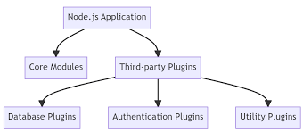

Slide 20
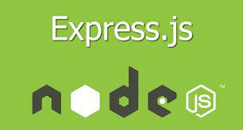
When it comes to building web applications using Node.js, creating a server can take a lot of time

Slide 21
let’s start
Express js is the framework of Node js, which is fully built-in Javascript. It was created by TJ Holowaychuk
It provides broad features for building web and mobile applications. It is used to build a single page, multipage, and hybrid web application.
Express allows you to respond to HTTP requests from clients, create dynamic endpoints, and process user input
It provides support for routing, HTTP methods, HTTP cookies, and what are called path variables.

Slide 22
Why we need express
One of the key advantages of using Express is that it helps you build RESTful APIs
: RESTful APIs are commonly used to create web services that have a predictable URL structure, consistent naming conventions, and standard response formats.
: By creating your RESTful API and using Express to build out the backend, you can ensure that your API is always accessible from anywhere in the world

Slide 23
It saves a lot of coding time almost by half and still makes web and mobile applications efficient
Another reason for using Express is that it is written in javascript.
Express lets so many new developers enter the field of web development

Slide 24
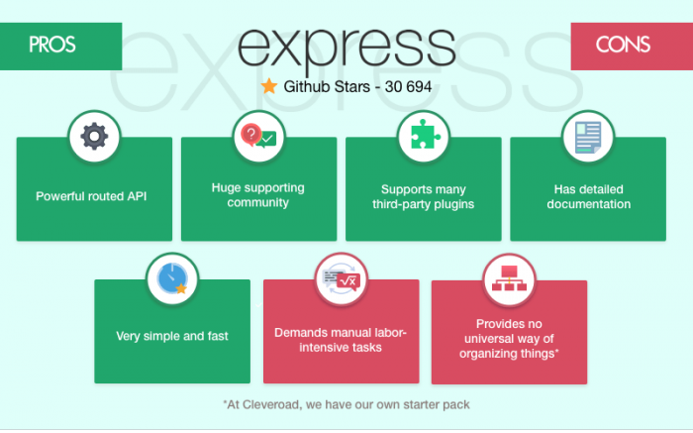

Slide 25
Features of Express JS
It can be used to design single-page, multi-page and hybrid web applications.
It allows to setup middlewares to respond to HTTP Requests.
It defines a routing table which is used to perform different actions based on HTTP method and URL.
It allows to dynamically render HTML Pages based on passing arguments to templates.

Slide 26
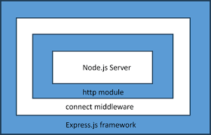
The Express.js is built on top of the connect middleware, which in turn is based on http, one of the core modules of Node.js API.

Slide 27
Routing
It refers to how an application's endpoint's URLs respond to client requests.
Templating
It provides templating engines to build dynamic content on web pages by creating HTML templates on the server.

Slide 28
Debugging
Express makes it easier as it identifies the exact part where bugs are.

Slide 29




Companies That Are Using Express JS

Slide 30
Installing Express:
Run the following command in the terminal:
npm init
A package.json file with node modules will be created
Then run the following command
npm install express --save

Slide 31
Express.js Request Object
Express.js Request and Response objects are the parameters of the callback function which is used in Express applications.
app.get('/', function (req, res) {
})
The express.js request object represents the HTTP request and has properties for the request query string, parameters, body, HTTP headers, and so on.

Slide 32
Express.js Response Object
The Response object (res) specifies the HTTP response which is sent by an Express app when it gets an HTTP request.
What it generally do
It sends response back to the client browser.
For ex….
res.json([body])
This method returns the response in JSON format.

Slide 33
Express GET method
GET and POST both are two common HTTP requests used for building REST API’s.
GET requests are used to send only limited amount of data because data is sent into header. It is not secure because data is visible in URL bar
POST requests are used to send large amount of data because data is sent in the body.

Slide 34
Express post method
Post method facilitates you to send large amount of data because data is send in the body.
Post method is secure because data is not visible in URL bar but it is not used as popularly as GET method.
On the other hand GET method is more efficient and used more than POST.

Slide 35
Middleware introduction…
When an HTTP request is received by the web server, express gives an object that contains details about the data, requested resource, IP address of the client, and some browser information.
This object is the request object (req). Similarly, a response object (res) is also provided by express. The response object can also be modified before being sent to the user.

Slide 36
Express.js middleware is various functions invoked by the express.js routing layer before the last request handler.
Express middleware functions are compiled during the lifecycle of the Express server. As the name indicates, Middleware appears between the initial request and the final intended route.
In stack, middleware methods are always invoked in the hierarchy to which they are added.

Slide 37
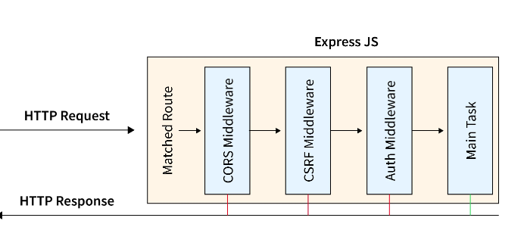

Slide 38
Middleware
Middleware is the layer that exists between the application components, tools, and devices.
With middleware, you can simplify connectivity between the components.
Node.JS middleware plays a prime role in the request-response lifecycle of Node.JS execution.

Slide 39
Middleware
Middleware functions are functions that have access to the request object (req), the response object (res), and the next middleware function in the application’s request-response cycle.
The next middleware function is commonly denoted by a variable named next.

Slide 40
Middleware functions can perform the following tasks:
Making quick changes to the request and response objects
Calling the next middleware immediately as per the stack
Effectively executing any code
Automatically terminating the request-response cycle

Slide 41
Middleware gets executed after the server receives the request and before the controller actions send the response

Slide 42
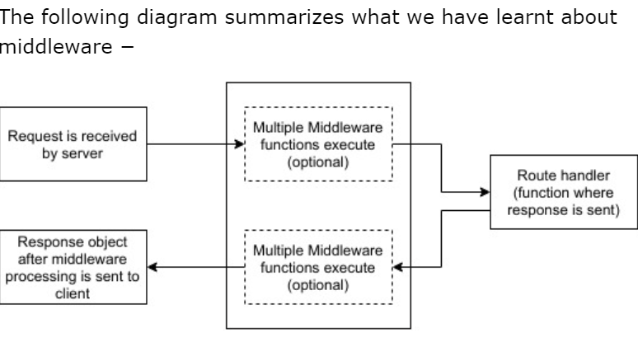

Slide 43
Middleware chaining
Middleware can be chained from one to another, Hence creating a chain of functions that are executed in order.
The last function sends the response back to the browser

Slide 44
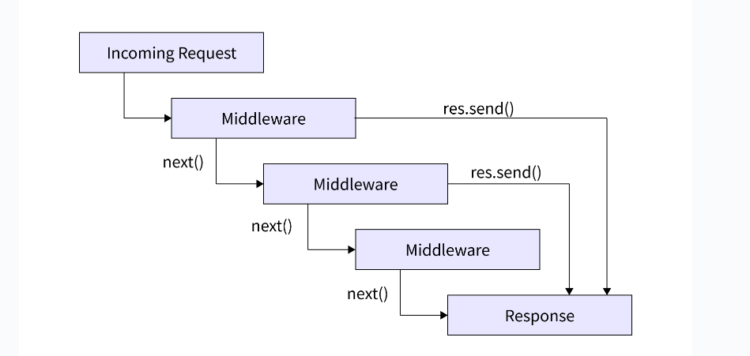

Slide 45
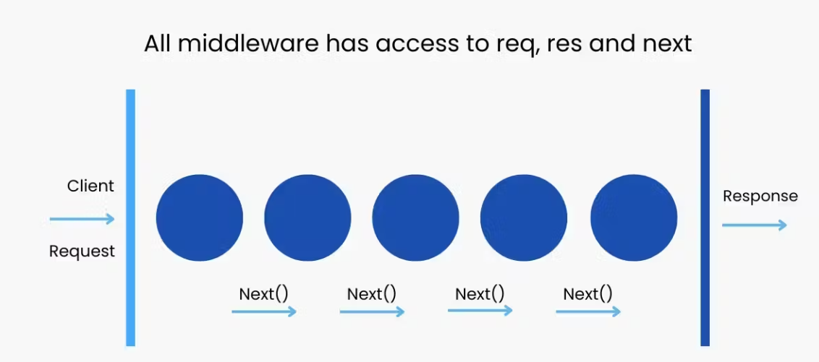

Slide 46
What is next()?
Next() is a middleware function that calls for the control of another middleware once the code is completed

Slide 47
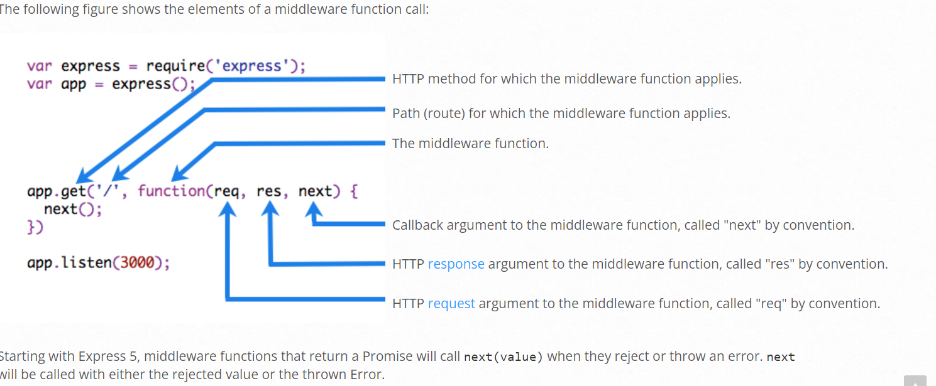

Slide 48
Types of middleware
Application-level middleware: Bound to the entire application using app.use() or app.METHOD() and executes for all routes.

Slide 49
const express = require('express');
const app = express();
const PORT = 3000;
app.use(function (req, res, next) {
console.log("Middleware called")
next();
});
app.get('/user', function (req, res) {
console.log("/user request called");
res.send('Welcome to nodejs');
});
app.listen(PORT, function (err) {
if (err) console.log(err);
console.log(`Server listening on PORT ${PORT}`);
});

Slide 50
const express = require('express');
const app = express();
const PORT = 3000;
app.get('/user', function (req, res) {
res.send("Handled GET Request");
});
app.post('/user', function (req, res) {
res.send("Handled POST Request");
});
app.delete('/remove', function (req, res) {
res.send("Handled DELETE Request");
});
app.listen(PORT, function (err) {
if (err) console.log("Error in server setup");
console.log("Server listening on Port", PORT);
});

Slide 51
Router-level middleware: Associated with specific routes using router.use() or router.METHOD() and executes for routes defined within that router.

Slide 52
const express = require('express');
const app = express();
const router = express.Router();
const PORT = 3000;
router.use(function (req, res, next) {
console.log("Middleware Called");
next();
})
router.use(function (req, res, next) {
res.send("Greetings from nodejs");
})
app.use('/user', router);
app.listen(PORT, function (err) {
if (err) console.log(err);
console.log("Server listening on PORT", PORT);
});

Slide 53
Contd..
Error-handling middleware: Handles errors during the request-response cycle. Defined with four parameters (err, req, res, next).

Slide 54
const express = require('express');
const app = express();
app.use((err, req, res, next) => {
console.error(err.stack);
res.status(500).send('Something went wrong!');
});
app.get('/error', (req, res, next) => {
const err = new Error('Intentional Error');
next(err);
});
const port = 3000;
app.listen(port, () => {
console.log(`Server is running on port ${port}`);
});

Slide 55
Built-in middleware: Provided by Express (e.g., express.static, express.json, etc.).
Third-party middleware: Developed by external packages (e.g., body-parser, morgan, etc.).

Slide 56
Example
Here is an example of a simple “Hello World” Express application.
we will use three middleware functions to the application: one called myLogger that prints a simple log message, one called requestTime that displays the timestamp of the HTTP request, and one called validateCookies that validates incoming cookies.

Slide 57
Middleware function myLogger
This function just prints “LOGGED” when a request to the app passes through it. The middleware function is assigned to a variable named myLogger.
const myLogger = function (req, res, next) {
console.log('LOGGED')
next()
}

Slide 58
Full code:
const express = require('express')
const app = express()
const myLogger = function (req, res, next) {
console.log('LOGGED')
next()
}
app.use(myLogger)
app.get('/', (req, res) => {
res.send('Hello World!')
})
app.listen(3000)

Slide 59
Middleware function requestTime
Next, we’ll create a middleware function called “requestTime” and add a property called requestTime to the request object.
const requestTime = function (req, res, next) {
req.requestTime = Date.now()
next()
}

Slide 60
Full code
const express = require('express')
const app = express()
const requestTime = function (req, res, next) {
req.requestTime = Date.now()
next()
}
app.use(requestTime)
app.get('/', (req, res) => {
let responseText = 'Hello World!<br>'
responseText += `<small>Requested at: ${req.requestTime}</small>`
res.send(responseText)
})
app.listen(3000)

Slide 61
Middleware function validateCookies
finally, we’ll create a middleware function that validates incoming cookies and sends a 400 response if cookies are invalid.
Here’s an example function that validates cookies with an external async service.

Slide 62
async function cookieValidator (cookies) {
try {
await externallyValidateCookie(cookies.testCookie)
} catch {
throw new Error('Invalid cookies')
}
}

Slide 63
Here we use the cookie-parser middleware to parse incoming cookies off the req object and pass them to our cookieValidator function. The validateCookies middleware returns a Promise that upon rejection will automatically trigger our error handler.

Slide 64
Full Code
const express = require('express')
const cookieParser = require('cookie-parser')
const cookieValidator = require('./cookieValidator')
const app = express()
async function validateCookies (req, res, next) {
await cookieValidator(req.cookies)
next()
}
app.use(cookieParser())
app.use(validateCookies)
app.use((err, req, res, next) => {
res.status(400).send(err.message)
})
app.listen(3000)

Slide 65
Middleware in connect
In Connect, a minimalist web framework for Node.js, middleware functions are essential components that handle requests, perform tasks, and pass control to subsequent middleware or route handlers.
Middleware functions have access to the request (req) and response (res) objects, as well as the next function in the application’s request-response cycle.

Slide 66
const connect = require('connect');
const app = connect();
function logger(req, res, next) {
console.log(`${req.method} ${req.url}`);
next();
}
app.use(logger);
app.use((req, res) => {
res.end('Hello, World!');
});
app.listen(3000, () => {
console.log('Server is running on port 3000');
});

Slide 67
Access Control with Middleware
Access control with middleware in Connect allows you to restrict access to certain routes or resources based on various criteria such as user authentication, roles, permissions, IP addresses, and more.
Middleware functions are placed in the request-response cycle and can be used to check incoming requests for specific conditions before allowing them to proceed to the next middleware or route handler.

Slide 68
Body-parser
Express body-parser is an npm library used to process data sent through an HTTP request body. It is responsible for parsing the incoming request bodies in a middleware before you handle it
It exposes four express middlewares for parsing text, JSON, url-encoded and raw data set through an HTTP request body.
These middlewares are functions that process incoming requests before they reach the target controller

Slide 69
npm install --save body-parser
You may have added a line to your code that looks like the following:
app.use(bodyparser.json()); //utilizes the body-parser package

Slide 70
We have to follow two steps:
First we will create an html file with name index.html
Then we have to create a javascript file with name probably app.js
Install body-parser middleware. Npm install body-parser
Npm install ejs

Slide 71
Index.html
<!DOCTYPE html>
<html>
<head>
<title>Body-Parser Module Demo</title>
</head>
<body>
<h1>Demo Form</h1>
<form action="saveData" method="POST">
<pre>
Enter your Email : <input type="text"name="email"> <br>
<input type="submit" value="Submit Form">
</pre>
</form>
</body>
</html>

Slide 72
App.js
const bodyparser = require('body-parser')
const express = require("express")
const path = require('path')
const app = express()
let PORT = process.env.port || 3000
app.set("views", path.join(__dirname))
app.set("view engine", "ejs")
app.use(bodyparser.urlencoded({ extended: true }))
app.use(bodyparser.json())
app.get("/", function (req, res) {
res.render("SampleForm")
});
app.post('/saveData', (req, res) => {
console.log("Using Body-parser: ", req.body.email)
})
app.listen(PORT, function (error) {
if (error) throw error
console.log("Server created Successfully on PORT", PORT)
})

Slide 73
Socket.io
Writing a chat application with popular web applications stacks like LAMP (PHP) has normally been very hard.
It involves polling the server for changes, keeping track of timestamps, and it’s a lot slower than it should be.
Sockets have traditionally been the solution around which most real-time chat systems are architected, providing a bi-directional communication channel between a client and a server

Slide 74
This means that the server can push messages to clients. Whenever you write a chat message, the idea is that the server will get it and push it to all other connected clients.
Socket.IO is a library that enables low-latency, bidirectional and event-based communication between a client and a server.

Slide 75
The Socket.IO connection can be established with different low-level transports:
HTTP long-polling
WebSocket
WebTransport

Slide 76
Socket.IO will automatically pick the best available option, depending on:
the capabilities of the browser (see here and here)
the network (some networks block WebSocket and/or WebTransport connections)

Slide 77
Features​
Here are the features provided by Socket.IO over plain WebSockets:
HTTP long-polling fallback​
The connection will fall back to HTTP long-polling in case the WebSocket connection cannot be established.

Slide 78
Automatic reconnection
Under some particular conditions, the WebSocket connection between the server and the client can be interrupted with both sides being unaware of the broken state of the link.
when the client eventually gets disconnected, it automatically reconnects with an exponential back-off delay, in order not to overwhelm the server.

Slide 79
Packet buffering
The packets are automatically buffered when the client is disconnected, and will be sent upon reconnection

Slide 80
Acknowledgements
Socket.IO provides a convenient way to send an event and receive a response
Sender
socket.emit("hello", "world", (response) => {
console.log(response); // "got it"
});

Slide 81
Receiver
socket.on("hello", (arg, callback) => { console.log(arg); // "world" callback("got it"); });

Slide 82
You can also add a timeout
socket.timeout(5000).emit("hello", "world", (err, response) => { if (err) { // the other side did not acknowledge the event in the given delay } else { console.log(response); // "got it" } });

